Slide 1
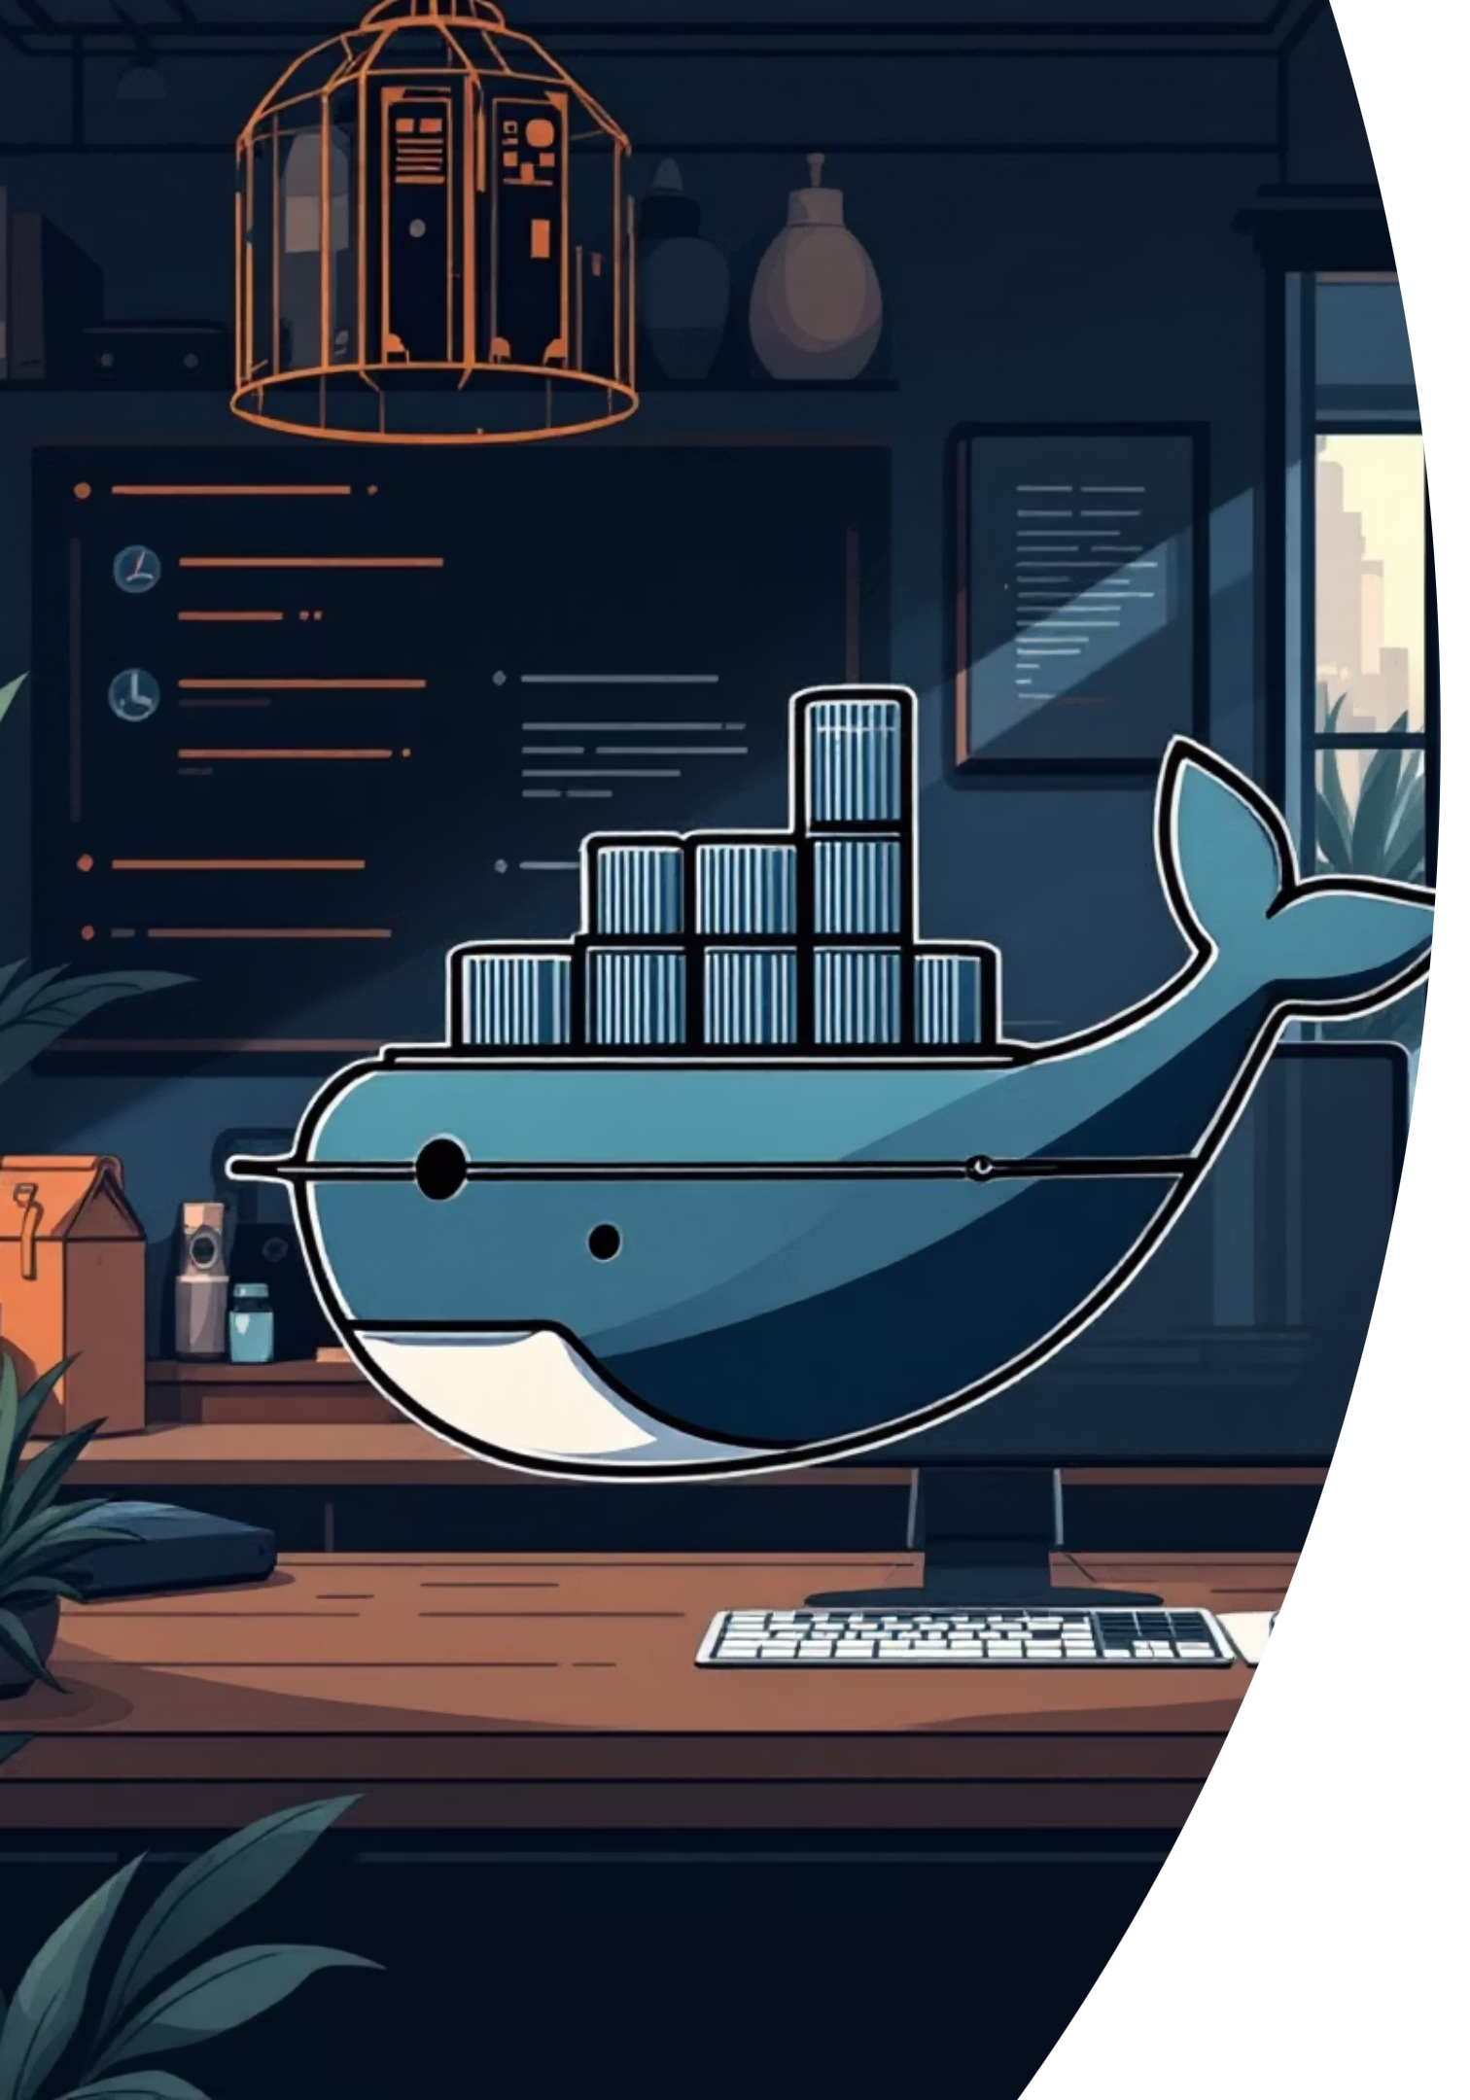
Docker Fundamentals for Developers
A comprehensive hands-on guide to mastering containerization with Docker. From understanding core concepts to deploying your applications, this presentation will take you through the essential skills every developer needs to build, ship, and run applications in containers.

Slide 2
Why Docker Revolutionized Development
Consistency
Efficiency
Scalability
"It works on my machine" becomes "It works everywhere." Docker ensures your application runs identically across development, testing, and production environments.
Containers share the OS kernel, making them lightweight and fast to start. Deploy hundreds of containers on a single server without the overhead of virtual machines.
Scale applications horizontally by spinning up new container instances. Orchestration tools like Kubernetes make managing thousands of containers seamless.
Docker transforms how we build, ship, and run applications by packaging everything your app needs into portable, lightweight containers that run consistently anywhere.

Slide 3
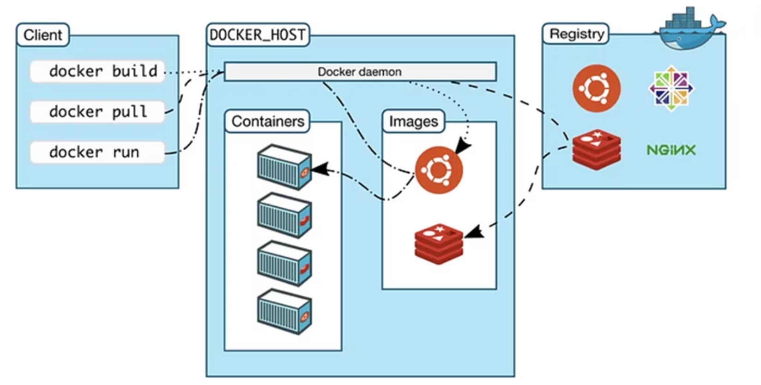
Docker Architecture Deep Dive
Docker Engine
The heart of Docker, consisting of three main components:
Docker Daemon (dockerd) - runs on host system
REST API - interface for communication
Docker CLI - command-line interface
Key Benefits
Application isolation without VM overhead
Rapid deployment and scaling
Version control for infrastructure
Docker uses a client-server architecture where the Docker client communicates with the Docker daemon, which builds, runs, and manages containers. Images serve as blueprints, while containers are running instances.
Simplified dependency management

Slide 4
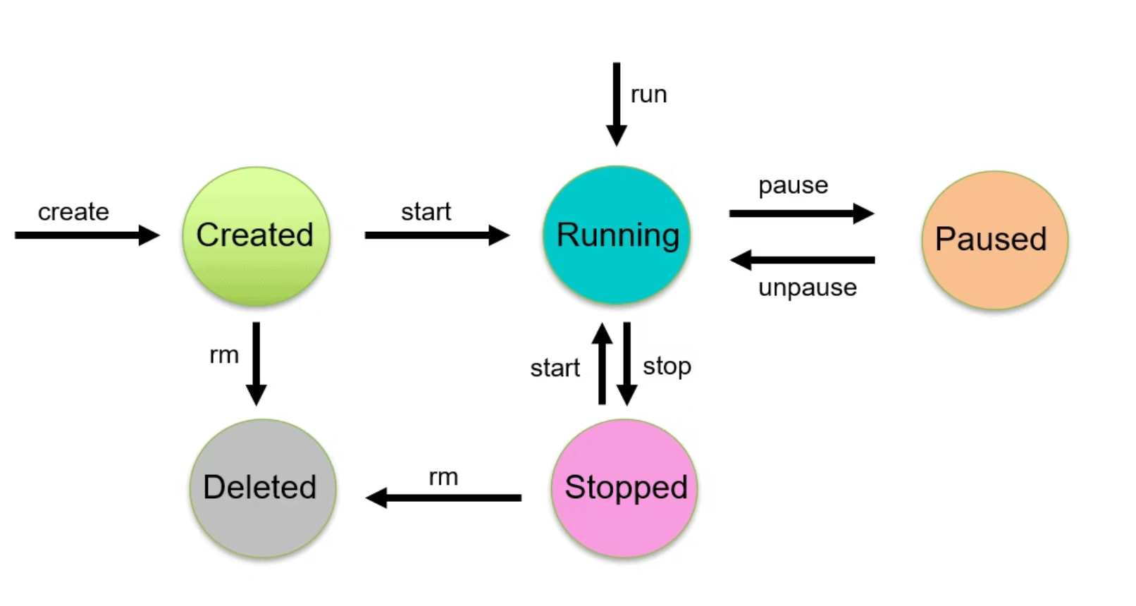
Container Lifecycle & Essential Terminology
Docker Daemon
Container Registry
Volumes
Background service managing containers, images, networks, and volumes on the host system
Centralized repository for storing and distributing container images (Docker Hub, ECR, GCR)
Persistent data storage that survives container lifecycle, shared between containers

Slide 5
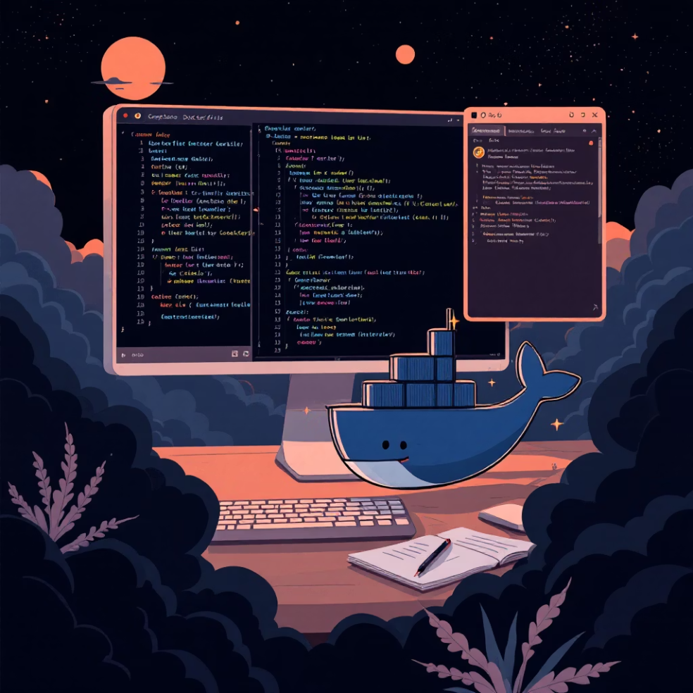
Docker File Structure Essentials
Dockerfile
FROM python:3.9-slimWORKDIR /appCOPY requirements.txt .RUN pip install -r requirements.txtCOPY . .EXPOSE 8000CMD ["python", "app.py"]
requirements.txt
flask==2.3.3requests==2.31.0gunicorn==21.2.0
.dockerignore
Each file serves a specific purpose in containerization. The Dockerfile defines the container blueprint, requirements.txt manages dependencies, and .dockerignore excludes unnecessary files from the build context for faster builds and smaller images.
__pycache__*.pyc.git.envnode_modulesREADME.md

Slide 6
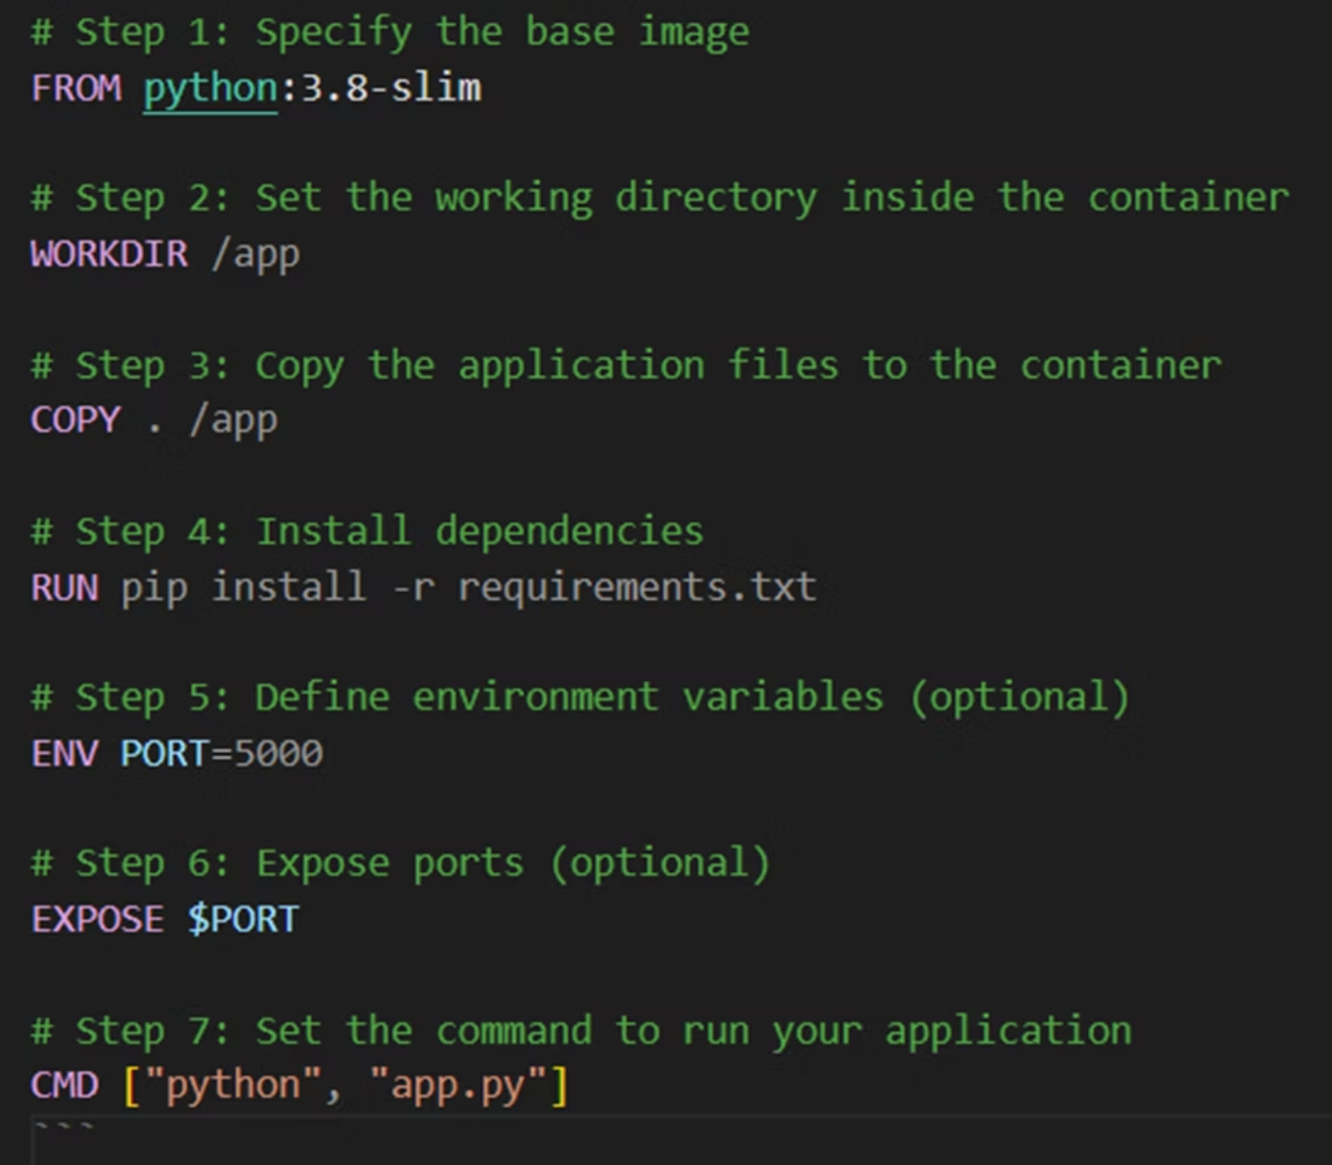
1. Dockerfile:
A Dockerfile is a script containing a series of commands that Docker uses to build an image. It defines the base image, dependencies, environment variables, and the commands to run your application. Here’s the basic structure:

Slide 7
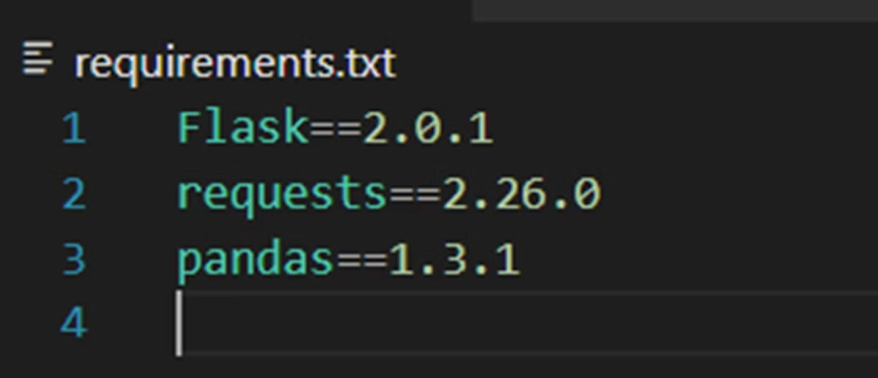
2. requirements.txt:
The requirements.txt file is used in Python projects to list all the packages and dependencies that your application needs to run. This file is often used in the RUN command within a Dockerfile to install dependencies.
pip install -r requirements.txt

Slide 8
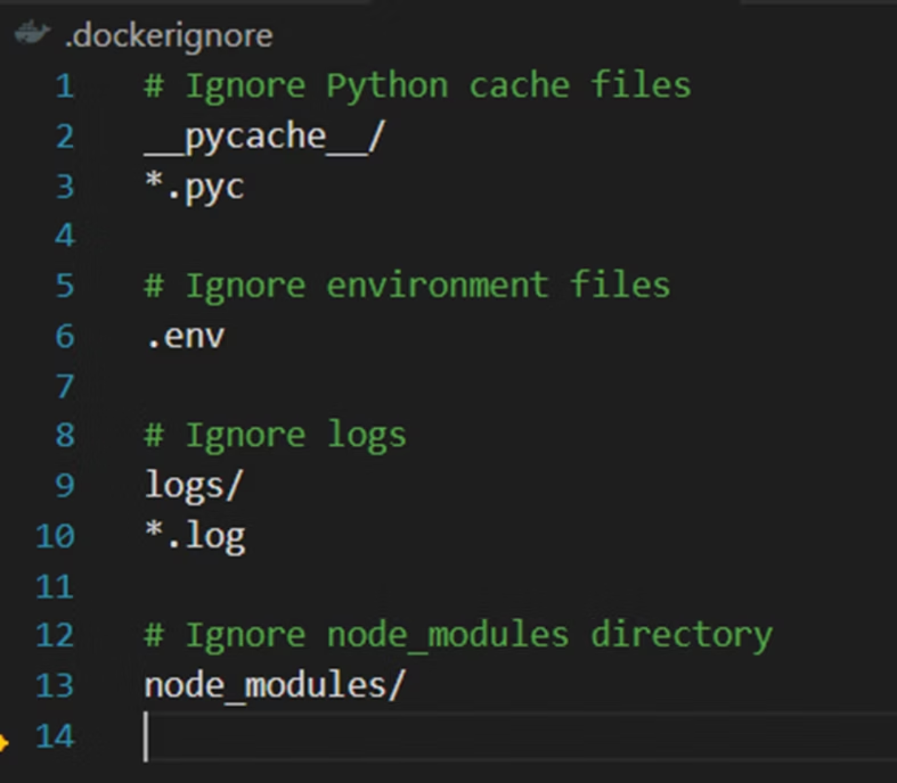
3. .dockerignore:
The .dockerignore file tells Docker which files and directories to ignore when building an image. It works similarly to .gitignore in Git.
Using a .dockerignore file can significantly reduce the size of your Docker images by excluding unnecessary files.

Slide 9
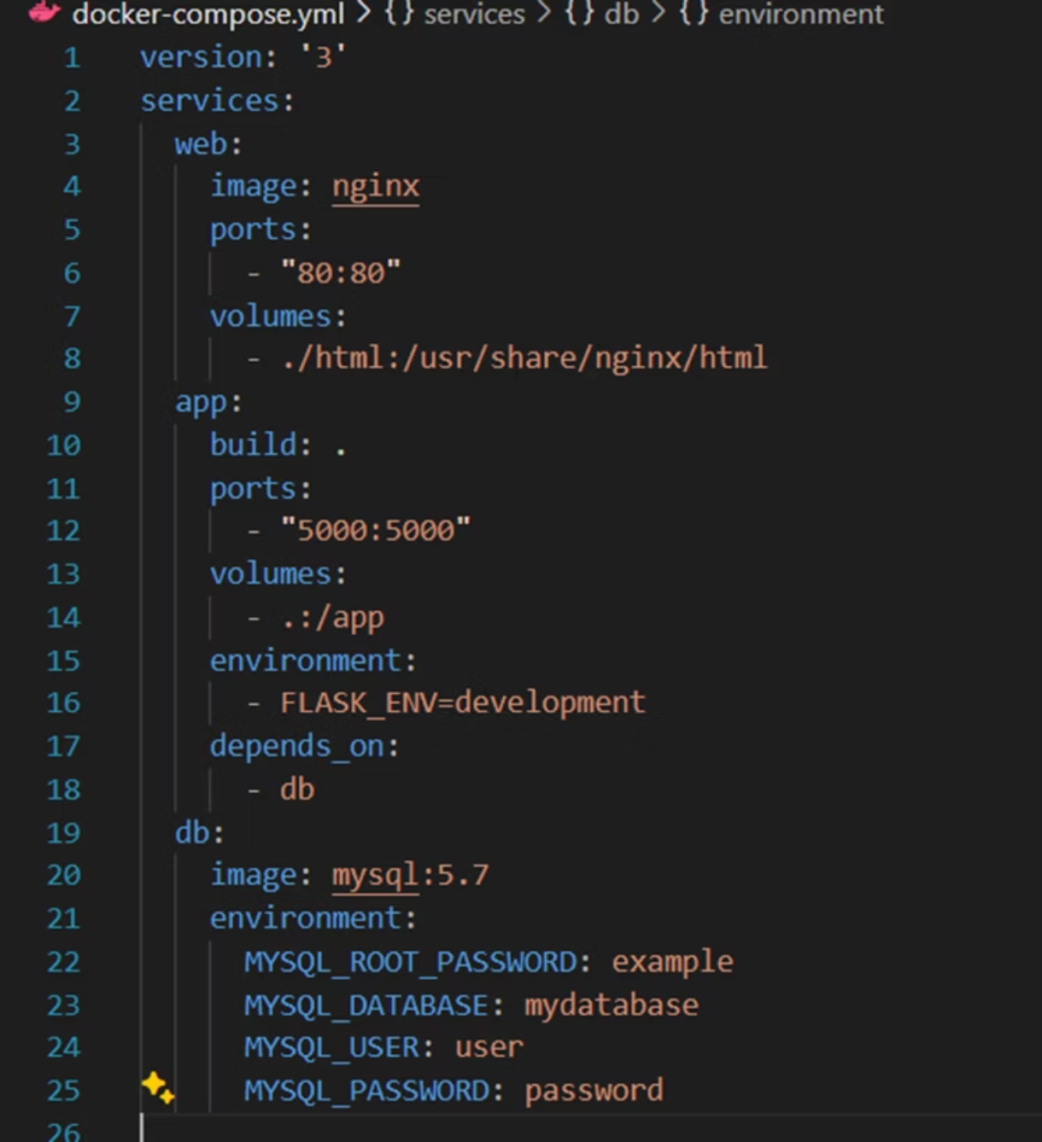
4. docker-compose.yml
The docker-compose.yml file is used by Docker Compose to define and manage multi-container Docker applications. It allows you to configure and run multiple services as part of a single application.
Each service can have its own image, ports, environment variables, volumes, and other configurations. The docker-compose.yml file makes it easy to start up all these services with a single command, docker-compose up.

Slide 10

Docker Hub: Your Container Registry
01
02
03
Account Setup
Repository Creation
Push & Pull
Create Docker Hub account and configure local authentication using docker login
Create public or private repositories to store your container images with version tags
Upload your built images and download community or official images for your projects
Images vs Containers
Best Practices
Image: Read-only template with application code
Use semantic versioning for image tags
Container: Running instance of an image
Keep images small and focused
Volume: Persistent storage independent of container lifecycle
Leverage multi-stage builds for production

Slide 11
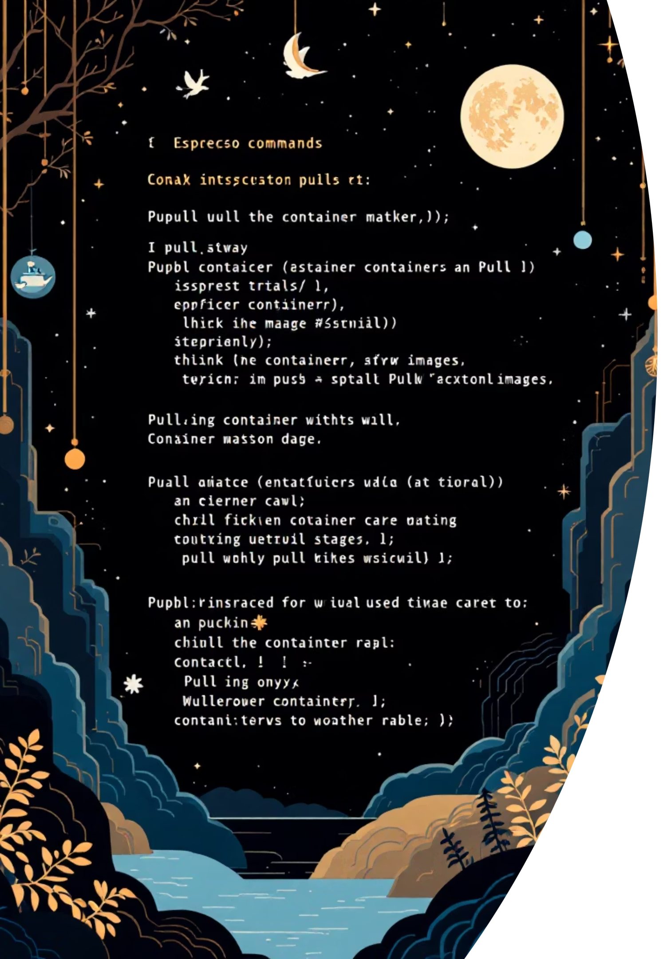
Hands-On: Pulling and Pushing Images
1
Pull Official Image
docker pull nginx:alpinedocker images
Download lightweight Nginx image and verify it's available locally
2
Run Container
docker run -d -p 8080:80 --name my-nginx nginx:alpinedocker ps
Start container with port mapping and background execution
3
Tag and Push
docker tag nginx:alpine yourusername/my-nginx:v1docker push yourusername/my-nginx:v1
Create custom tag and upload to your Docker Hub repository

